Slide 1
Sat-to-Map
Shagun Uppal (2016088)
Sarthak Bhagat (2016189)

Slide 2
Problem Statement
Learning mappings from one image to another has been a problem of great interest since recent times in the field of image analysis, computer vision and learning models.
With this project, we aim to develop an image-to-image learning model, which will be able to synthesis an aerial map image of a given satellite image.

Slide 3
Dataset Used
The dataset containing satellite images and their corresponding map images obtained via web-scraping from Google Maps provided publicly by UC Berkeley CS Dept.
The dataset contained a total of 2194 (train + test) such pairs.
Original Size of image was 1200x600, which was cropped to get map and satellite image of size 600x600 each.
These images were then resized to obtain images of size 128x128 each.
We also web-scraped images of Indian landscape to test our already trained models.

Slide 4
Approaches Used
Convolutional Neural Networks (Baseline): This is a simple neural network consisting of convolution layers. CNN’s learn on the basis of learning the loss function to enhance the quality of the results, the loss function being manually defined as per the task taken into consideration.
Variational Autoencoder: This is an autoencoder consisting of an encoder and decoder and a gaussian prior imposed on the latent space. The training approach is based on reducing the reconstruction loss between the predicted and ground truth images.
Generative Adversarial Network: This is a complex model consisting of a generator capable of producing fake data samples (images in our case) and a discriminator whose job is to differentiate between the real and the fake samples. The learning is influenced by the min-max tradeoff between the generator and the discriminator.

Slide 5
Results For Different Models :
Convolutional Neural Network : 32% (Viewer Score)

Slide 6
Variational Autoencoder : 0% (Viewer Score)

Slide 7
Generative Adversarial Network : 68% (Viewer Score)

Slide 8
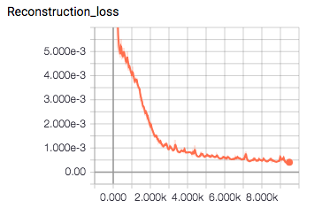
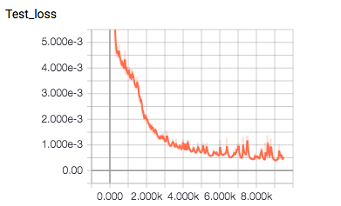
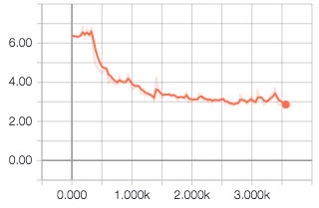
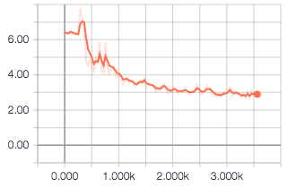
Analysis
CNN Train Loss
CNN Test Loss
VAE Train Loss
VAE Test Loss

Slide 9
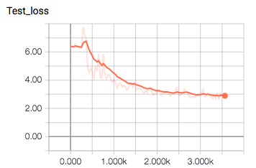
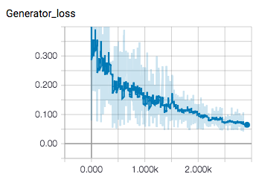
GAN Test Loss
Generator Train Loss

Slide 10
Individual Contribution
Shagun Uppal
Data Processing
Train a Generative Adversarial Network
Analysis and Plots
Sarthak Bhagat
Web Scraping for obtaining satellite and map images of Indian landscapes
Train a Variational Autoencoder
Train a Convolutional Neural Network

